Slide 1

Black Friday Sales: A Comprehensive Look
Fatema Nourzaie
Loveleen Bangar
Minda Aguhob

Slide 2
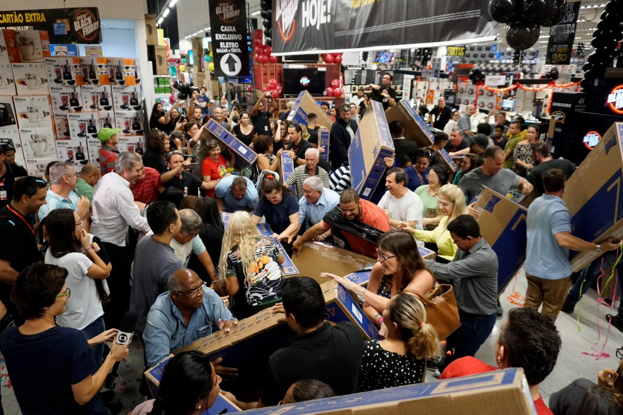

Background
Black Friday is known as a major shopping event occurring on the immediate Friday after the Thanksgiving Holiday in the U.S. Black Friday is typically characterized as an event for shopping centers and retail stores to hold massive sales on their store products. The project will take a dataset observing Black Friday sales and provide conclusions based on the analysis.

Slide 3



Research Questions
Q1: Based on gender, which group shows the greatest value for purchase amount?
Q2: Which city category shows the greatest value for purchase amount?
Q3: Which occupation categories show the greatest value for purchase amount?
Q4: How does marital status show an effect on purchase amount?
Q5: For each product category (1,2,3) which product is the most popular?

Slide 4
Methods
Data was sourced from https://www.kaggle.com/mehdidag/black-friday.
The data set consists of 550,000 rows and 12 columns.
Variables observed for the project were age, gender, marital status, city type, purchase amount, and product category (1,2,3).
Age, gender, marital status, city type were analyzed as categorical data.
Dummy variables were created for gender and age in order to analyze them as categorical data.
Data observed in all Product Category columns were cleaned for any missing values within their respective analyses.
Purchase amount was considered as discrete values.
Data analysis was conducted using Pandas and MatPlotlib.
Data was plotted and shown in results.
Statistical analysis on the dataset can be viewed here: https://github.com/loveleenb/analysis_project/blob/master/Black_Friday_Analysis.ipynb

Slide 5
Analysis based on Age Groups and Gender
Table 1: Purchase Amount by Age Group among Males
Table 2: Purchase Amount by Age Group among Females
Age | Purchase Amount
0-17 | 90,832,391
18-25 | 699,459,830
26-35 | 1,565,891,426
36-45 | 771,639,085
46-50 | 298,621,230
51-55 | 273,935,949
55+ | 152,664,446
Age | Purchase Amount
0-17 | 41,826,615
18-25 | 202,209,450
26-35 | 433,857,680
36-45 | 239,010,480
46-50 | 114,796,993
51-55 | 87,972,407
55+ | 44,950,396

Slide 6
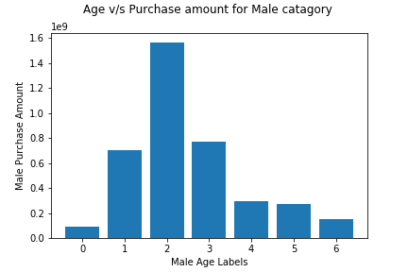
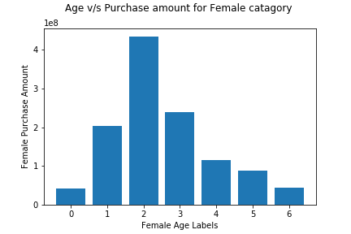
Graph for Purchase Amount across Age Groups among Men or Women

Slide 7
Q1: Based on gender, which age group shows the greatest value for purchase amount?
Age group 26-35 for male and female had the highest purchase amount respectively
Gender group with the greatest purchase amount sum are males.
Males had the greatest purchase amount value across all age groups.
The analysis provides information that can potentially be used for future sales marketing during Black Friday.
For example, products that are catered to the 26-35 year old age demographic can potentially bring the best returns.
Notes:
The analysis shows the gender group with the greatest purchase amount sum are males. This is also true when looking exclusively at the purchase amount among the age group with the highest purchase amount value (age group 26-35, in both males and females have the greatest purchase amount).

Slide 8
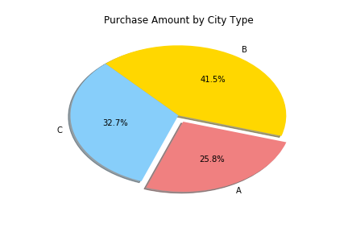
Analysis based on City Category
City Category and Purchase Amount
Table 3: Purchase Amount Sum for each City Category
City Category | Purchase Amount
A | 1,295,668,797
B | 2,083,431,612
C | 1,638,567,969

Slide 9
Q2: Which city category shows greatest value for purchase amount?
The analysis shows the city category with the greatest purchase amount value is city category B with the highest percentage of total purchase amount among all cities. Followed by city category C.
City category type can provide further insight on where future sales will do the best in. Conversely, knowing city category types that experience low purchase amounts can indicate where to improve sales/advertising.

Slide 10
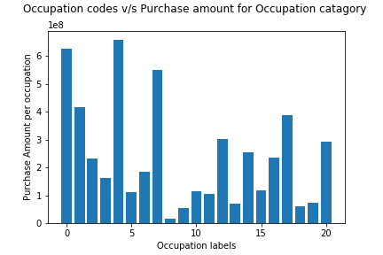
Analysis Based on Occupation Category
Purchase Amount across Occupation Types

Slide 11

Q3: Which occupation category shows greatest value for purchase amount?
Occupation category “4”, “0”, “7” had the highest purchase amount value in that order.
Occupation category “8” had the least purchase amount value.

Slide 12
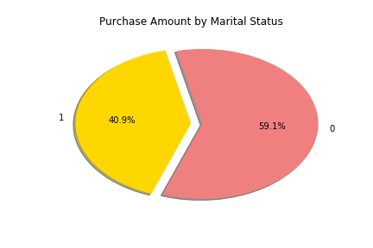
Analysis based on Marital Status
Marital Status and Purchase amount
Marital Status Code | Purchase Amount
“0” | 2,966,289,500
“1” | 2,051,378,878

Slide 13


Q4: How does marital status show an effect on purchase amount?
The analysis shows that marital status code “0” has a greater purchase amount value than marital status code “1”
VS

Slide 14
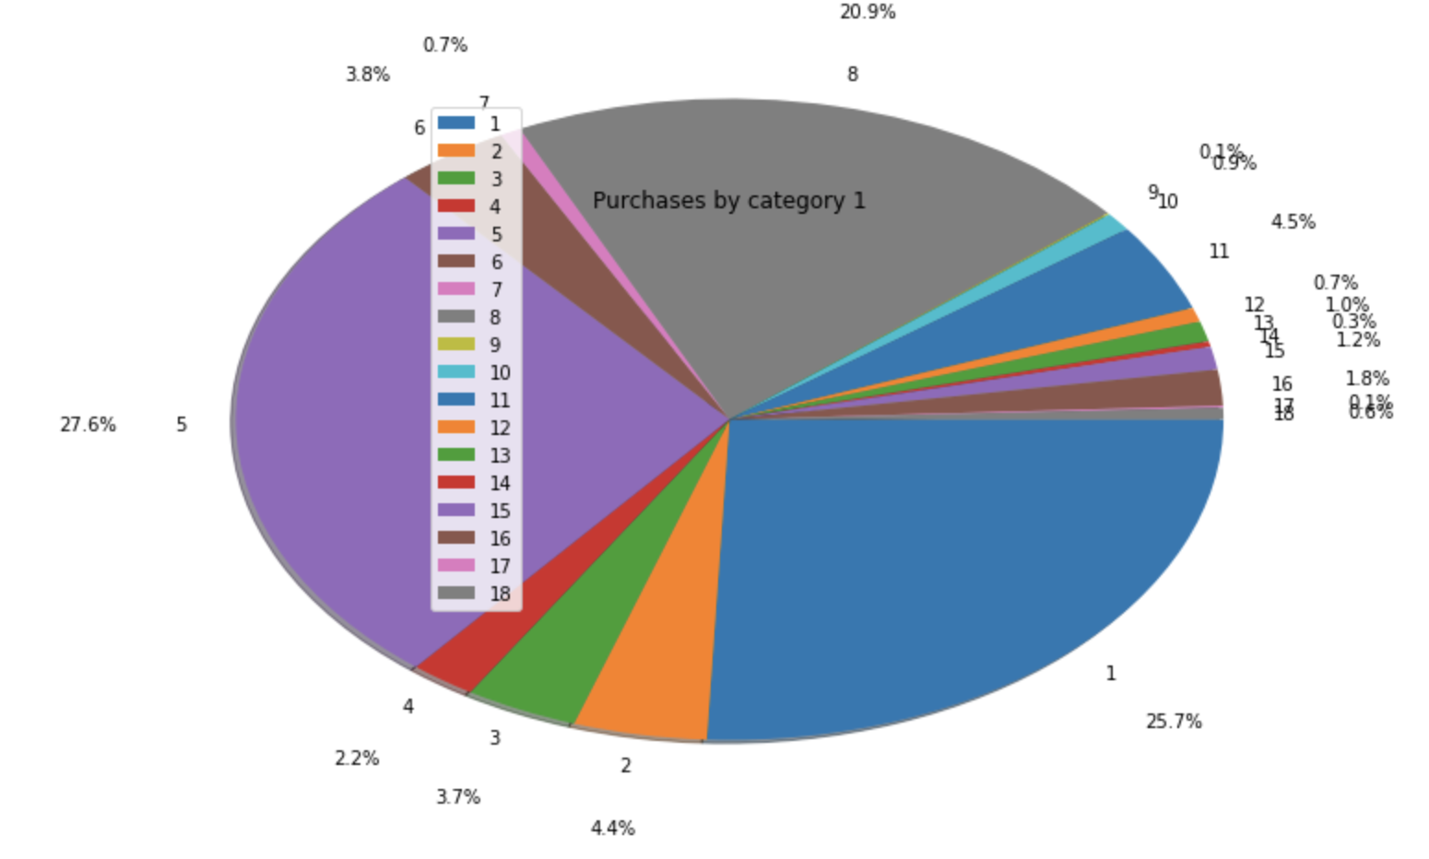
Analysis for Product Category 1
Purchase counts for product types found in Product Category 1
Pie chart for product category 1, charts for categories 2 & 3 can be found via Jupyter notebook link

Slide 15
Q5: For each product category (1, 2, 3), which product is most popular?
Product popularity is calculated as number of counts found per product.
In product category 1, product 5 is the most popular and product 9 is the least popular.
In product category 2, product 8 is the most popular and product 7 is the least popular.
In product category 3, product 16 is the most popular and product 3 is the least popular.

Slide 16
Limitations
Purchase amount value based on gender is limited.
The dataset has more observations of male purchase amounts, which may not be entirely indicative of shopping or purchase behavior on Black Friday. This can also be due to sampling bias.
Further analysis needs to be done observing an equal group of male and female shopping behavior/ purchase amount.
Dataset does not have revenue explicitly stated.
Provides unclear picture on product success and revenue generated
No description of codes
Creates limited definition of variables

